Slide 1
Addressing Anti-Black Racism November 25, 2020
NIRSA Canada Roundtable
Notes:
Welcome - Recording
Andrew Pettit, my pronouns are he/him

Slide 2
Toronto and Ryerson University are in the
“Dish With One Spoon Territory”
The Dish With One Spoon is a treaty between the Anishinaabe, Mississaugas and Haudenosaunee that bound them to share the territory and protect the land.
All others are invited into this treaty.

Slide 3
Agenda
Welcome & Recording
Why me?
What to expect today
Ryerson’s strategy, efforts and results to date
Other efforts, resources
Q & A
Notes:
COVID welcome - health and safety, ups and downs

Slide 4
Why me?
What to expect today?
Notes:
Why me
NIRSA Canada Recreation Directors/Managers call
Some schools have made progress, many others paused or prepping, due to COVID and I’m guessing knowledge, confidence, leadership
I shared that at Ryerson we had a plan and we’re making progress
People asked if I should share and here we are
Director, Recreation, Equity & Active Well-Being → Equity focus is across our department, Rec and Varsity
4th year at Ryerson, 12 years at McMaster
Canadian University Sport Pilot Project to Address Homophobia / Transphobia
Stair Vice Chair of McMaster’s campus wide advisory committee on building an inclusive community
Many years at McMaster and last 4 at Ryerson: key focus on increasing staff capacity around building equitable programs
But, it’s important to note that I am a white, straight, cis man… Relative privilege and not my lived experience, but I am learning how to listen and have had generous teachers, and a track record of prioritizing and acting on equity issues
What to expect today
Unlike most presentations, I don’t have anything near completed work and results to share
My aim is to…
Share the framework we’re moving through at Ryerson, how we got there, experience so far
Highlight other efforts and work underway in our Canadian Ath-Rec context
Open the floor for others to share their work, learnings and questions

Slide 5
Our strategy and approach
Notes:
All white Strategic Leadership Team → both a problem and ours to own, but we need to listen
Support of a Black staff person, Natalie, who has asked to remain behind the scenes, but has been incredibly important moving our early thinking forward
My title, but a shared responsibility across SLT and all staff → I provide framework, support education, etc.

Slide 6
What we’ve done / are doing
Our strategy and approach
Staff Workshops
BIPOC Staff Group
Ongoing education
Department-wide + unit-specific action plans
Notes:
My historical approach: Assess, educate, act, repeat.
We started out thinking assessment was the place to start - but then decided we would use broader understanding to identify the issues that - if they exist outside our walls, must also exist inside - and moved to education and action.
Important to note: For better and worse, we’ve been very limited in our communication, cautious about talk vs. walk

Slide 7
Addressing Anti-Black Racism in our Work
Our Strategy
Initial focus on full-time staff and building a shared understanding and language to begin the work of unpacking and addressing anti-black racism in our various sub-communities, policies and processes.
Step 1 - September 2020: Workshops with facilitator via Zoom, building a shared understanding, language and ability to identify anti-Black racism in our work
Step 2 - Fall 2020: Staff teams work to identify issues and opportunities specific to our work areas
Step 3 - Ongoing: Integrate anti-racism, anti-oppressive approaches in our work - ongoing efforts and regular check-ins, progress assessments, etc. with supervisors and broader staff
Notes:
Shared foundation: We talk about equity issues regularly, so the basic concept of equity over equality, etc. is embedded in our thinking and ways of doing.
Knowledge of anti-Black racism specifically needed to be strongerEducation first, knowing people are coming from different places of lived experience and learning.

Slide 8
Staff Workshops

Slide 9
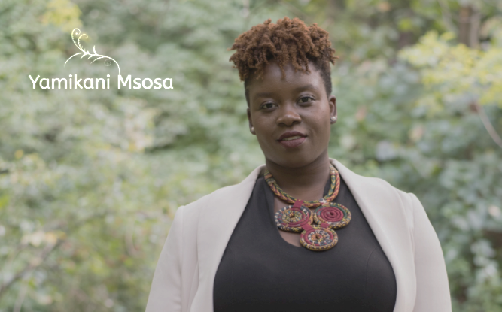
Anti-Black Racism Workshops: Yamikani Msosa
Our Facilitator
Yamikani Msosa (ze/hir) is a facilitator who works with organizations and communities, and movements. Yamikani is committed to a practice of anti-oppression, equity, diversity and inclusion using popular culture, creative facilitation, emergent strategy and digital engagement. Ze completed hir Master’s degree in Women and Gender Studies at Carleton University and Certificate from Michigan State University on Equity, Diversity and Inclusion and Organizational Change.
yamimsosa.com

Slide 10
Anti-Black Racism Workshops: Sep-21 & Oct-2
Schedule
This week: Pre-workshop survey - to be shared via email
Mon-Sep-21: Session 1 - Introduction to Anti-Black Racism
Group 1: 9:30am-12:00pm | Group 2: 1:30-4:00pm
Fri-Sep-25: Guided reflection in small groups
Fri-Oct-2: Session 2 - Solidarity In Action + BIPOC Only Breakout Room
Group 1: 9:30am-12:00pm | Group 2: 1:30-4:00pm
Week of Oct-5: Post-workshop survey via email

Slide 11
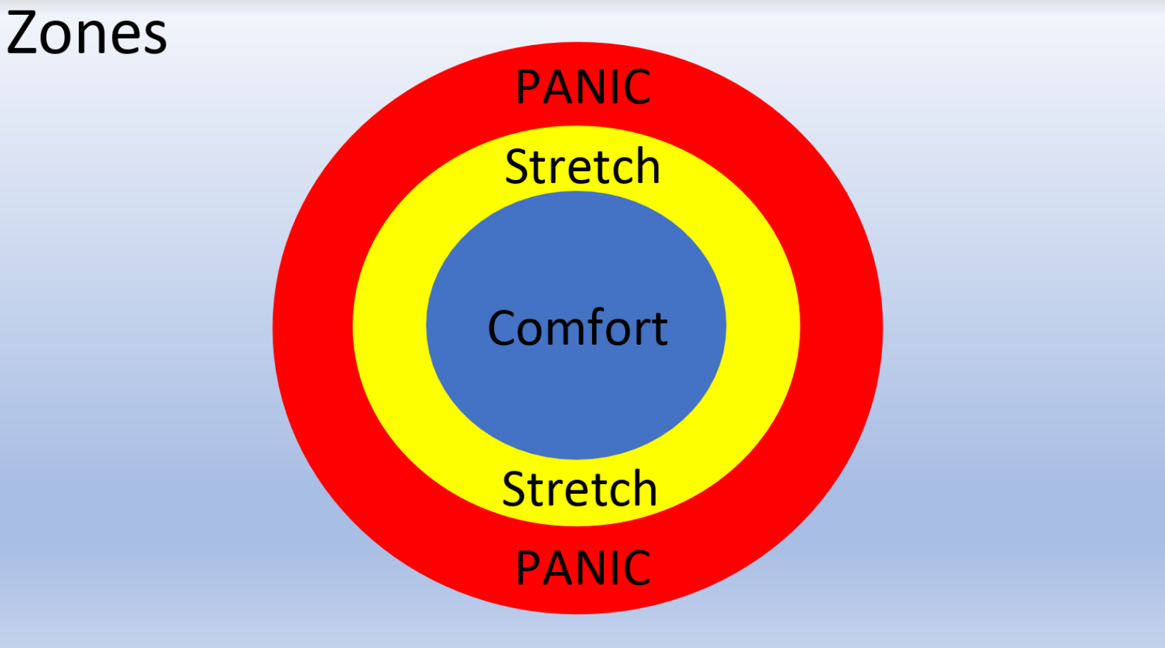
Credit: Yamikani Msosa | yamimsosa.com
Notes:
Yami presented this, and it’s been true. Naming the discomfort of the ‘stretch’ as a desired and necessary outcome has been important.

Slide 12
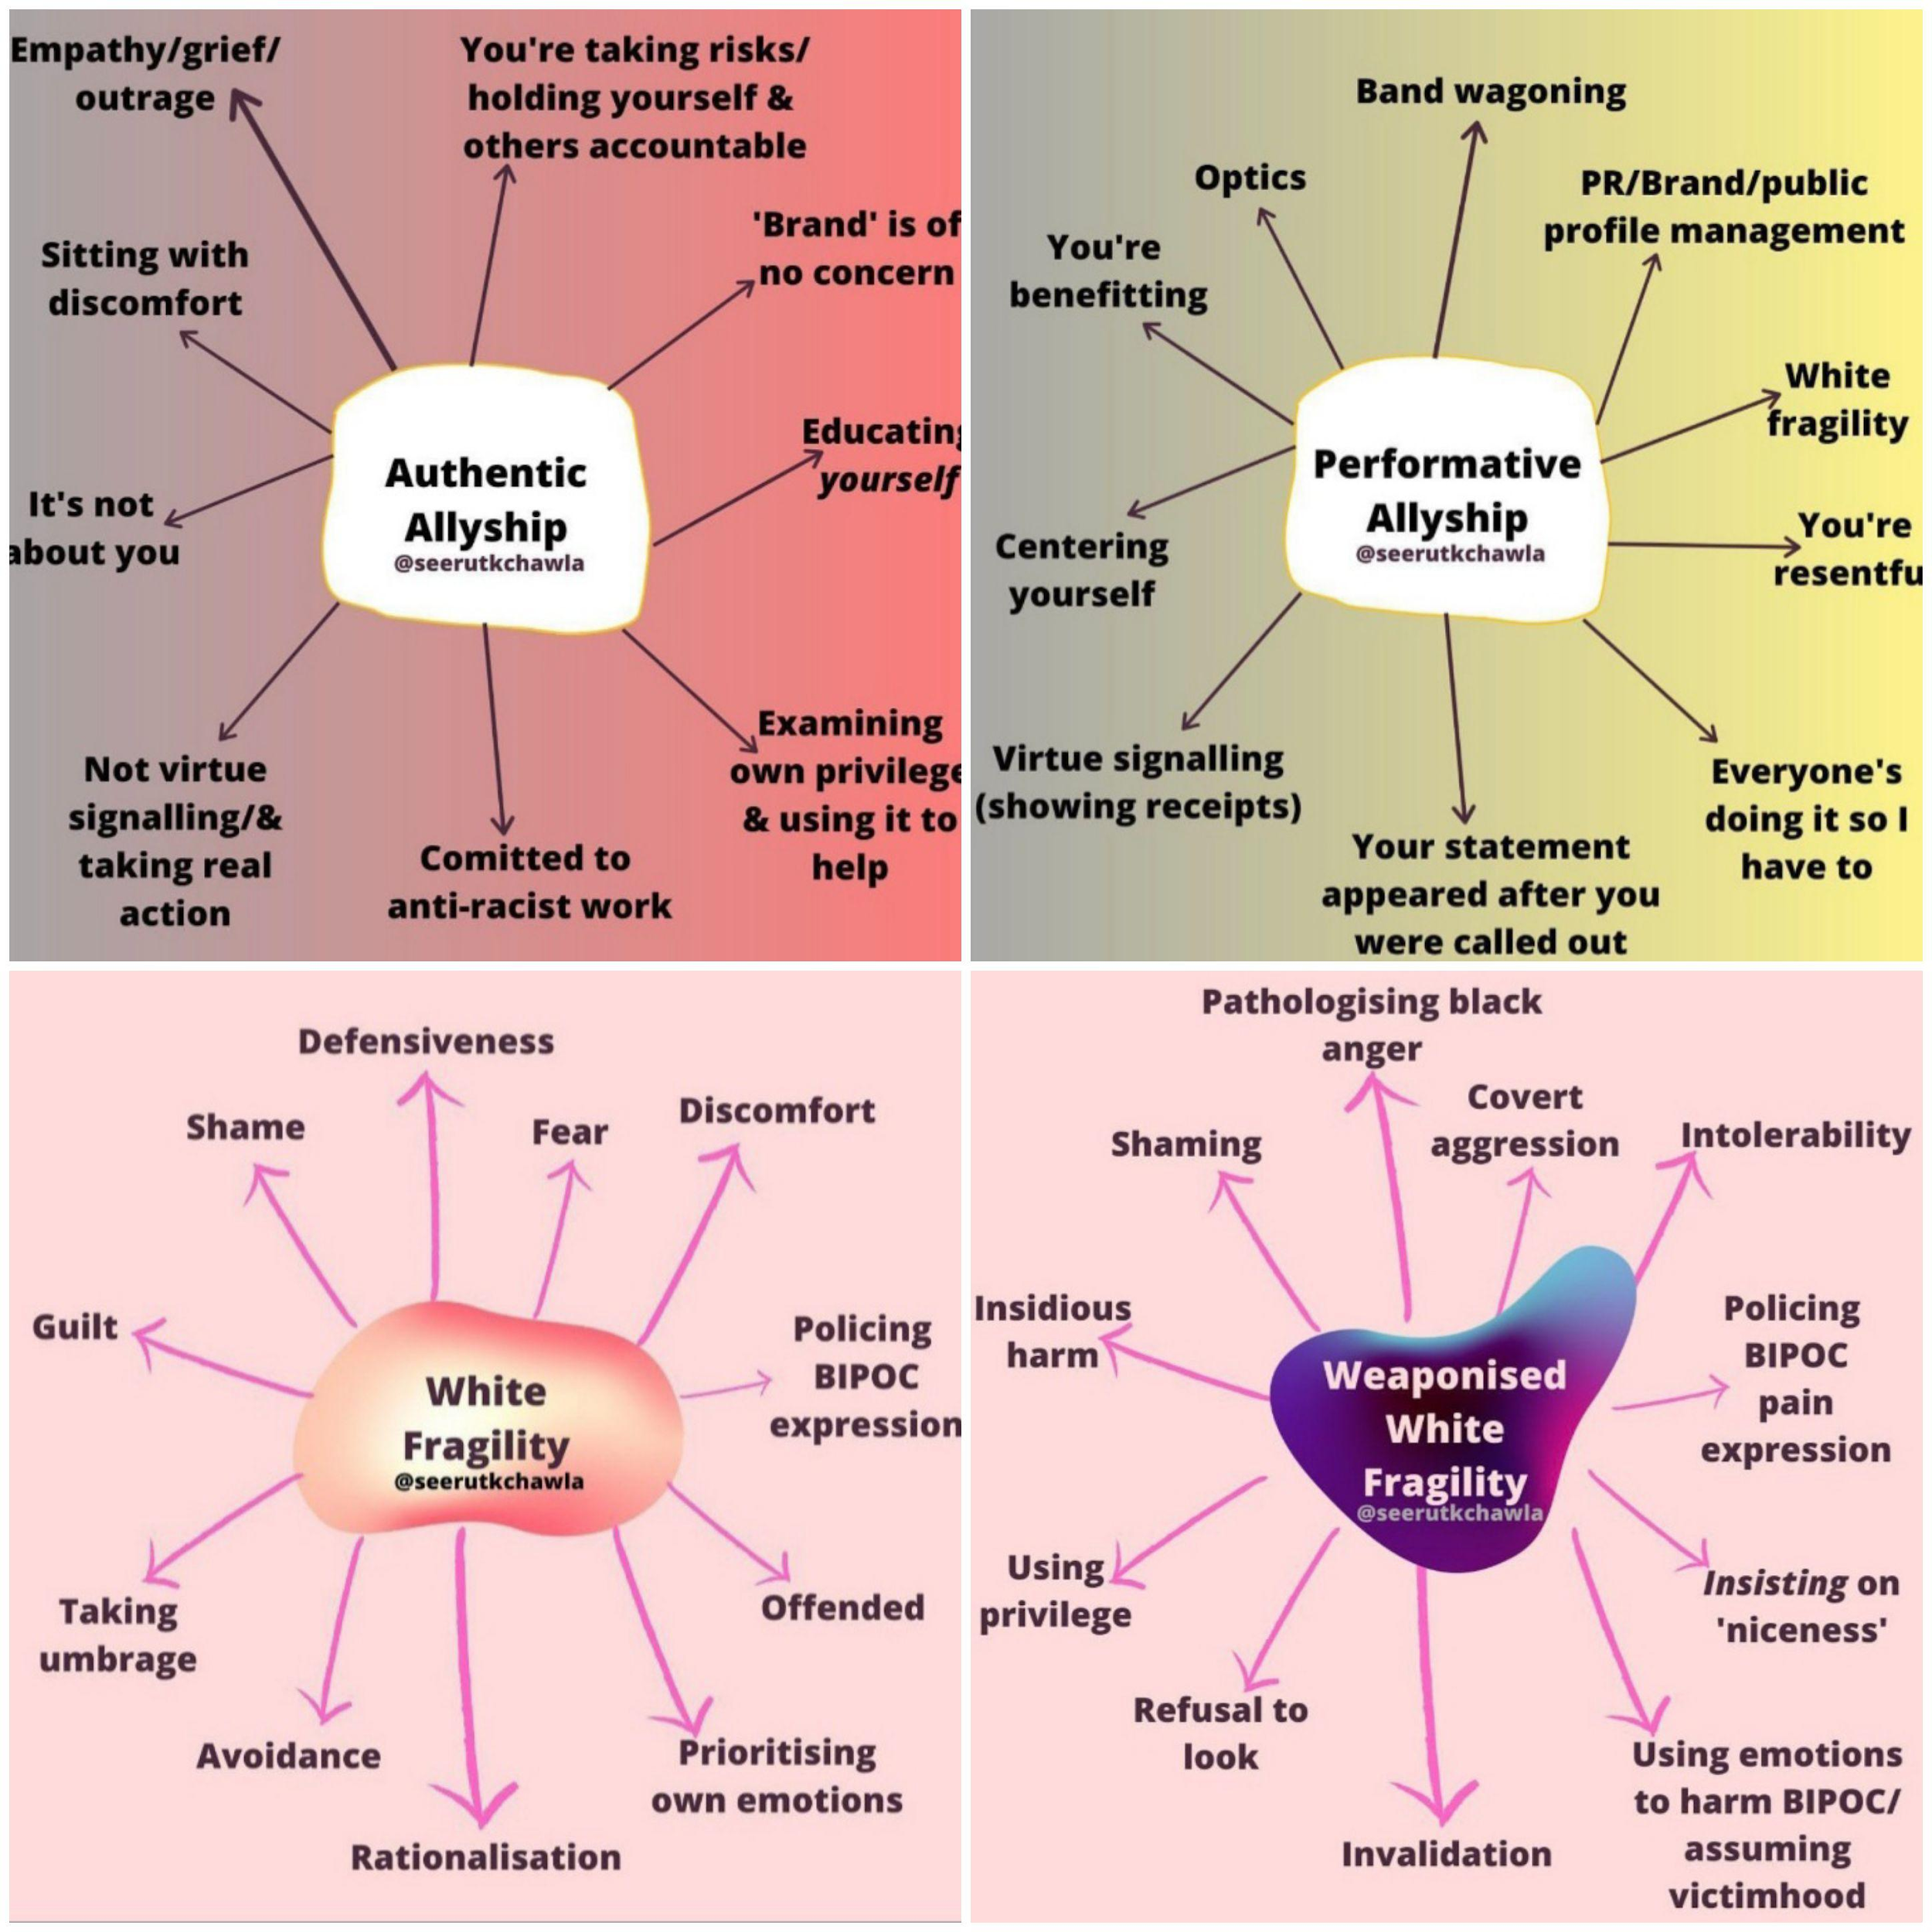
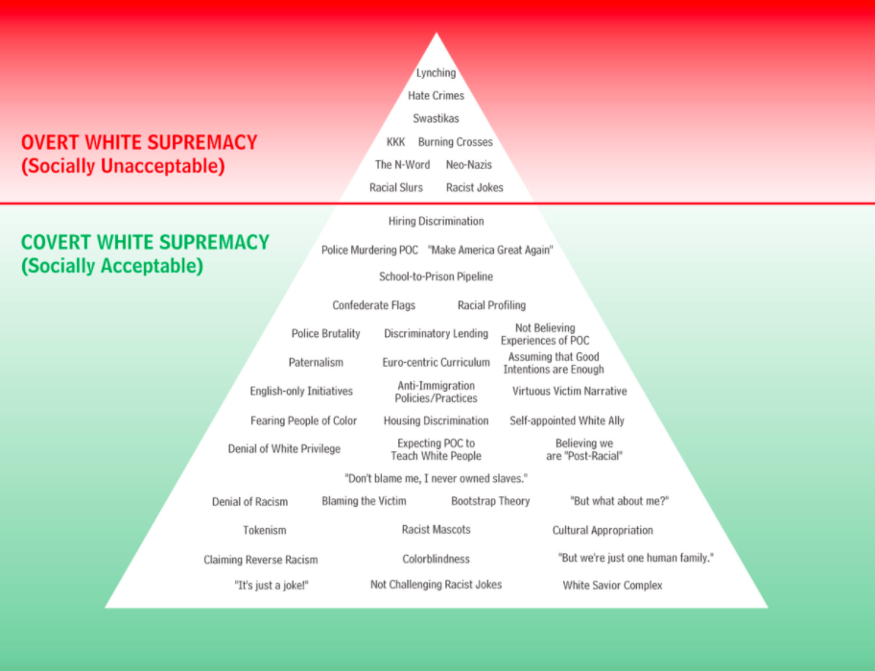
Credit: Yamikani Msosa | yamimsosa.com
Notes:
Breakout rooms where we discussed how these issues play out in our personal thinking / work → great effort to ensure people feel comfortable, understand importance/power in being vulnerable.
Also very thoughtful scenarios to work through specific to our work.

Slide 13
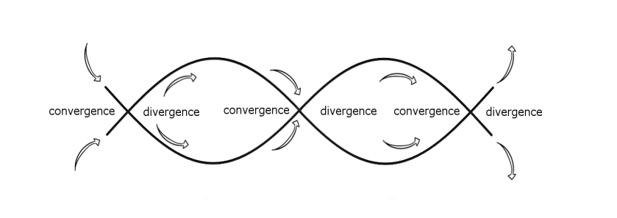
Organizational Change
Credit: Yamikani Msosa | yamimsosa.com
Notes:
Yami’s suggestion: Development of timeline to chart our progress, remind people of the longer process

Slide 14
Guided Group Reflection
Small groups with assigned questions, staff mixed across different units
Summary of group discussions / responses

Slide 15
1. Reflecting on your experience in the session and since, where have you been in terms of the comfort-stretch-panic continuum? Can you identify ways in which you have embraced or resisted the discomfort of learning/unlearning?
People see the need to learn, are willing to stretch out of the comfort and panic zones, but are afraid to act or to speak up.
Importance of education;
People willing to learn, but uncomfortable to share, afraid to say the wrong thing
Not knowing what to say or do resulting in doing and saying nothing
A sense of ultimate responsibility to change what is covert/acceptable in our environment
Goal setting in order to make changes seem less impossible
Review the way we do things
Give people equal opportunities
Not being racist is not enough

Slide 16
2. What thought or thoughts have become clearer or crystallized for you since attending our first session? Put another way, what was your key learning or takeaway?
Need to learn more
Racism in our cultural DNA / systemic - need to continuously unlearn
Need to be anti-racist instead of not racist
Mutual feeling of being uncomfortable with the theme and the issue
Continuous work/conversation/discussion
Action plan needs to be implemented
We can and need to do better as a team

Slide 17
3. What question(s) or concern(s) have emerged or persist for you since our first session? What are you hoping will be addressed, clarified or expanded upon in the next session?
All groups wanted to know what will happen next, what do do, how to proceed from here;
How to apply what we learned;
How to be supportive;
How to be part of the solution.

Slide 18
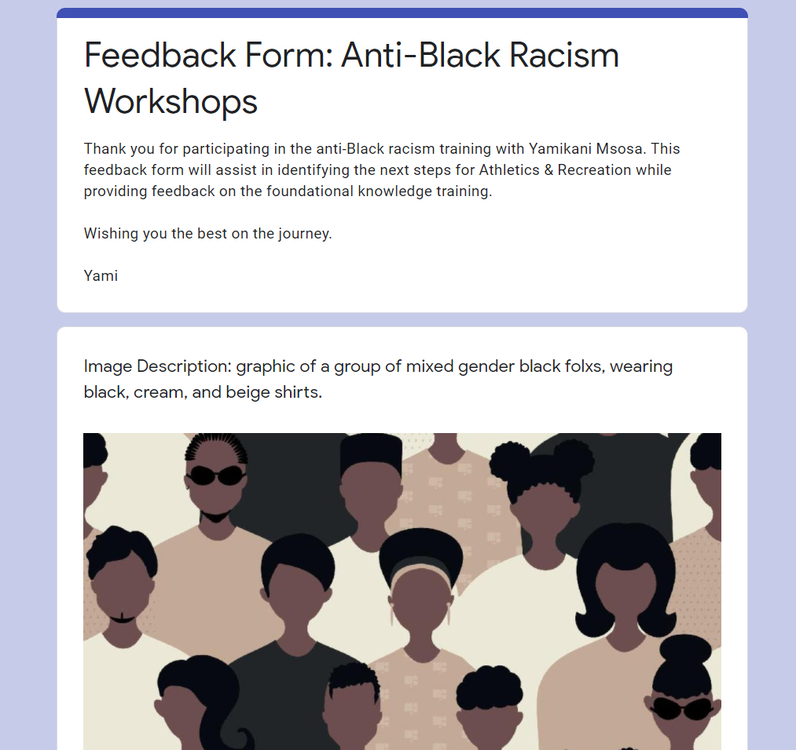
Post-workshop Survey
Summary of responses

Slide 19
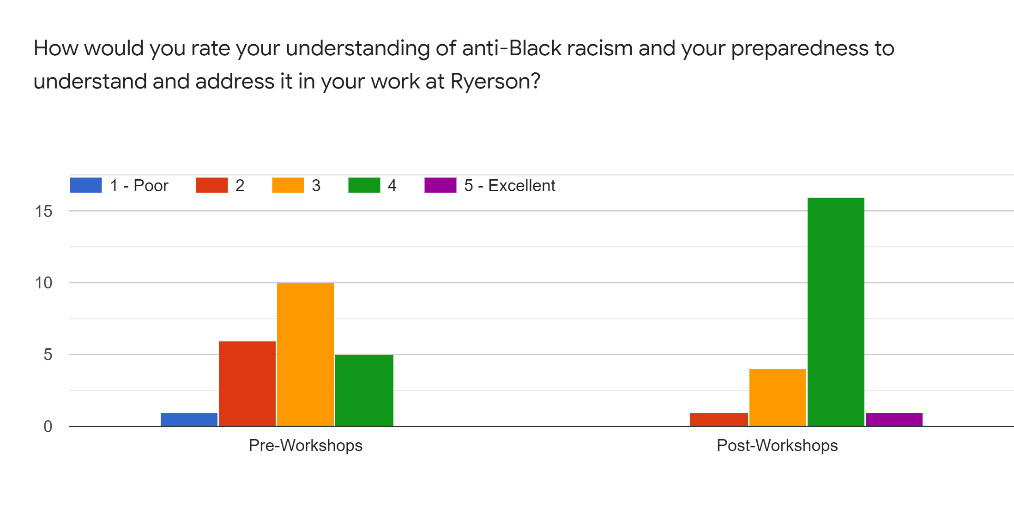
Pre vs. Post Knowledge & Preparedness

Slide 20
What did you value about the sessions?
“The opportunities to discuss anti-Black racism with my colleagues, and to be able to openly discuss the systemic issues within our institution.”
“Public and small group breakout sessions when my Black colleagues were brave enough to share personal lived experience was incredibly eye opening for me. While I appreciate the potential burden that this process can put on my Black colleagues, no book could possibly create the same experience as hearing from someone I work with.”
“An open forum to ask questions and be asked questions that challenge our pre-existing conceptions of anti-Black racism.”

Slide 21
What could have been better?
‘More breakout room time, and with co-workers from shared areas of work.’
‘Given we were working to address a lack of education, educated facilitators in each breakout room would have been helpful.’
“Working in small groups was helpful to share...however there were times when individuals were put on the spot to produce examples and insight that felt a bit rushed or forced.”
“I would have liked everyone to have more of a chance to speak with Yami in a smaller group setting.”
‘Next steps!!!!!!!!!!!’

Slide 22
BIPOC Staff Group
Notes:
Origins in the breakout room
Continued offer of connection → go on your own, but invite me / senior leaders in as need be, sensitivity to burden/unpaid labour required

Slide 23
BIPOC Staff Group: Update & Reflection
Small group of BIPOC staff meeting to reflect, connect, share
Intention to meet before and after group-wide sessions to guide us
Inviting AP and others in as desired
Reflection from last meeting
Notes:
The technology is subtle, pervasive, persistent
Even mid-way through a very early meeting, still working to understand where they stand as a group and already feeling need to be strategic about how their group or their concerns and recommendations will be perceived by our wider staff team → already posturing around being careful if/how/when to upset the dominant and white status quo.

Slide 24
What’s next for us

Slide 25
Learning from what’s happening around us
Ryerson Anti-Black Racism Climate Review
OUA / USports committees
McMaster Anti-Black Racism Review
NIRSA 21 Day Challenge, Roundtable in November
Notes:
The plan is two-fold relative to these reports:
Assign these reports to small groups of staff to read, reflect on together, and report back key considerations to incorporate in our work. Strategy = education + whole-group responsibility.
Share with student-staff and student-athletes acknowledging these issues live outside and inside Ryerson, highlighting our efforts so far and asking: What do you see here? What would you prioritize for us at RU?

Slide 26
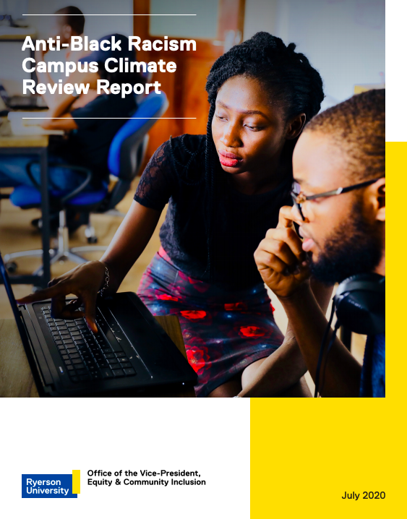
Anti-Black Racism on Campus In 2010, the Taskforce on Anti-Racism at Ryerson University released a report that examined systemic racial issues and barriers on campus. A few years later, the student group Black Liberation Collective–Ryerson, raised new concerns regarding the prevalence of anti-Black racism on campus. In response to these concerns and as the tenth anniversary of that report approached, the university embarked on the Anti-Black Racism Campus Climate Review in 2019. Latest report released on July 17 2020.

Slide 27
OUA BBI Taskforce
Mandate: To use the BBI Task Force as a platform to make positive change across the province, through building strategies to increase diversity and representation across the OUA, and to drive policy change to remove systemic barriers regarding racism
→ OUA AGM Report

Slide 28
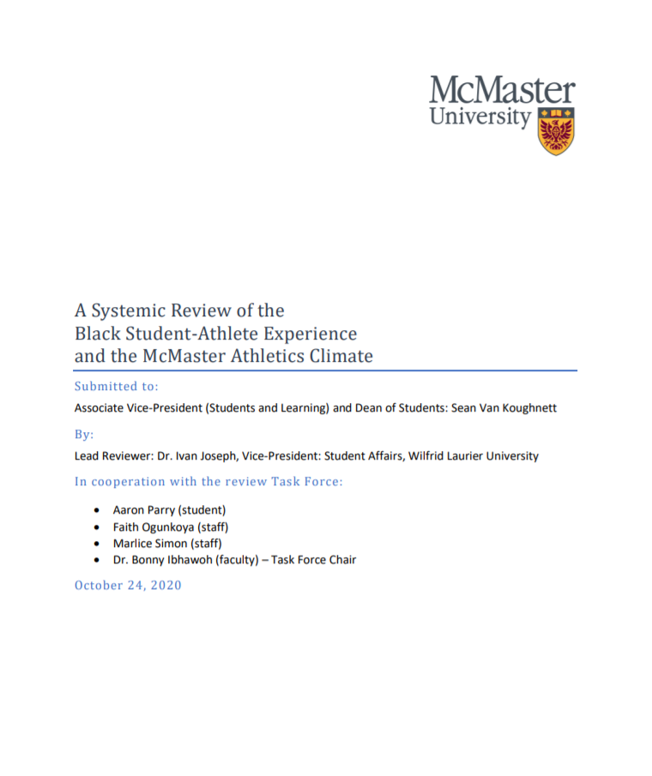
McMaster Anti-Black Racism Review
“This report is the outcome of a systemic review of the Black student-athlete experience and McMaster Athletics culture and climate over the last ten years following reports of anti-Black racism from former student-athletes.”
→ Released October 27, 2020

Slide 29
NIRSA 21 Day Challenge
The concept of the 21-Day Challenge was introduced several years ago by diversity expert Eddie Moore, Jr. to create greater understanding of the intersections of race, power, privilege, supremacy, oppression and equity. We are grateful to him for publicly sharing and encouraging others to use this concept as an educational tool.
This event initially ran in Fall 2020. Did you miss out? Now you can sign up for an on-demand version of this Challenge!
Notes:
Full disclosure: I have heard great things, but yet to take part. My understanding from others is that this covers much of the content we at Ryerson worked through together in our workshops.
Has anyone taken part and want to share perspective / highlights?

Slide 30
Department & Unit-specific Action Plans
Strategic Leadership Team Tasks
Review 5 key issues identified in OUA BBI report:
Anti-Racism Policy, Hiring Policies, Education & Anti-Racism Training, Financial Access and Mental Health
Setting strategy and accountability framework for all units, including in new strategic planning process
Hiring practices in near term...slow down
Recruitment strategy
Unconscious bias training
Transparent and intentional sharing of development opportunities

Slide 31
Department-wide & Unit-specific Action Plans
Unit-specific action plan framework
Provide framework of drill-down into their unit
Areas of focus
Reporting expectations (mechanism and timeline)
Resourcing re: education, human, etc.
Use OUA BBI report example:
Problem → Impact → Recommendations → What is success
Make it concrete: Walk through an example
Notes:
To be shared at Dec-2 all-staff meeting

Slide 32
Source: OUA BBI Task Force - AGM Report

Slide 33
What’s next: Medium-Long Term / Ongoing
Medium-Term
Drill-down into work areas to identify issues / opportunities
Engaging student-athletes, student-staff
Develop action plans including quicker wins and longer-term targets
Longer-Term / Ongoing
Identify further education required - ad hoc, informal vs. all staff
Set targets and timelines → include in department strategic planning process and individual performance plans

Slide 34
Q & A

Slide 35
andrew.pettit@ryerson.ca

